Slide 1
Blockchain and Cryptocurrency
CHAPTER TWO
ADAMA SCIENCE AND TECHNOLOGY UNIVERSITY
SoEEC – cse department – software engineering program

Slide 2
Block
The following are important attributes of every Bitcoin block:
Block hash - A unique identifier for the block. The block hash is generated from input data that provides a snapshot of the current state of the blockchain within 256 bits of data. This snapshot is like a technical version of a balance sheet for the entire Bit‐ coin blockchain. A Bitcoin block does not contain its own block hash, but it does contain the hash of the previous block it is building on, which is what makes the blocks chained. A block hash can be found by hashing the block header.
Coinbase transaction - This is the first transaction of each new block mined on the network. It adds new bitcoin to the supply, which is given as a reward to the miner who adds the block to the chain.
Block height number - This number identifies how many blocks there are between the current block and the first block in the chain (also known as the Genesis block).
Merkle root - This is a hash that allows proof of the validity of the blockchain

Slide 3
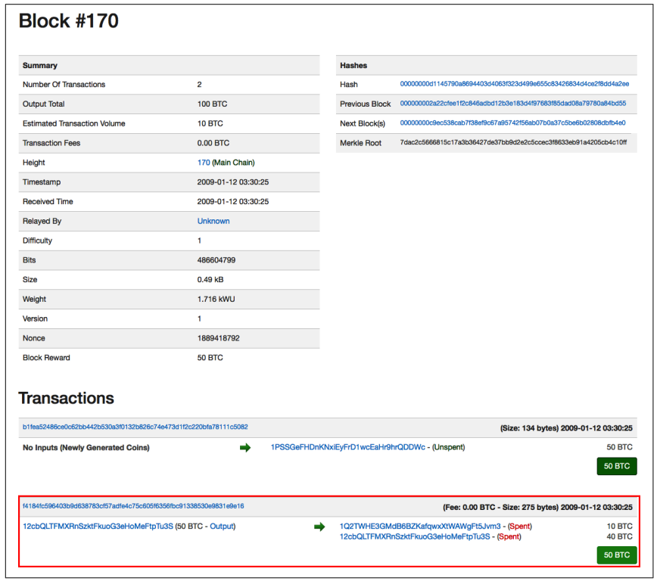
Bitcoin Block #170
Bitcoin block #170, which records a transaction of 10 BTC sent from Satoshi Nakamoto to developer and early blockchain pioneer Hal Finney

Slide 4
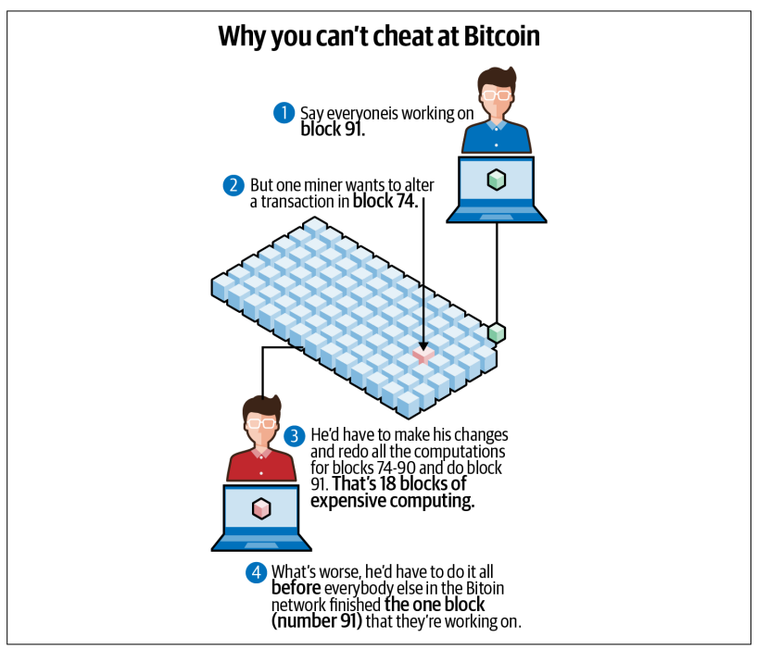
Why it would be hard to change a past transaction.
Why it’s difficult to roll back bitcoin transactions

Slide 5
Hashes
A cryptographic hash is a function that converts any form of data into a fixed-size string. Hashes have the following attributes that make them attractive for blockchain:
No matter the input, the resulting hash will always be a fixed length. For example, the hash generated by SHA-256 will always be 256 bits long.
A hash is a one-way encryption, meaning it is easy to encrypt the data.
Conversely, it is extremely difficult, if not impossible, to decrypt the hash back to the original input data. The only way to decrypt a hash without a private key is through brute force, which basically means trying every possible combination of input data and seeing if the resulting hash matches the valid hash.
A hash is deterministic. This means every time the same input data is entered, the resulting hash will always be the same. It is also easy to re-create a hash later using the same inputs and compare it to the original to see if any tampering or corruption of data has occurred.
Any slight change to the input data makes the resulting hash look very different. This adds to the difficulty of decrypting a hash.
Cryptographic hashes are collision resistant. It is extremely unlikely to find two different input values that yield the same hash value. This means every unique input will have a unique output.

Slide 6
There are many different cryptographic hash algorithms. Two of the most common are: •
SHA-256, commonly used by Bitcoin
Keccak-256, commonly used by Ethereum
A common use case for a hash is a secure website storing a hash of your password in its database. Let’s say your password for the website www.store.com is FNj`{:;`k#F43rQ\.
For extra protection the website’s database will store not the password, but a hash of the password. If the website uses the hash function SHA-256, the resulting string stored in the database will be:
Then, when you log in, the website only needs to verify the entered password by com‐ paring the hash of the string you typed in to the hash stored in its database.
This process makes the website more secure because if a hacker breaks into the database, they’ll only get the hashes of customer passwords.

Slide 7
Block Hashes
A block hash is a snapshot of what the entire blockchain looked like at the moment that block was created. In accounting terms, it’s like a balance sheet for the entire network.
Every node in the network refers to the block hash to verify that its view of the network is the exact same as everyone else’s.
If there’s even one minor difference in a node’s ledger, its hash will look significantly different.
This is what makes blockchain tamper-evident; if the content experiences tampering or corruption, the resulting hash will no longer be the same.

Slide 8
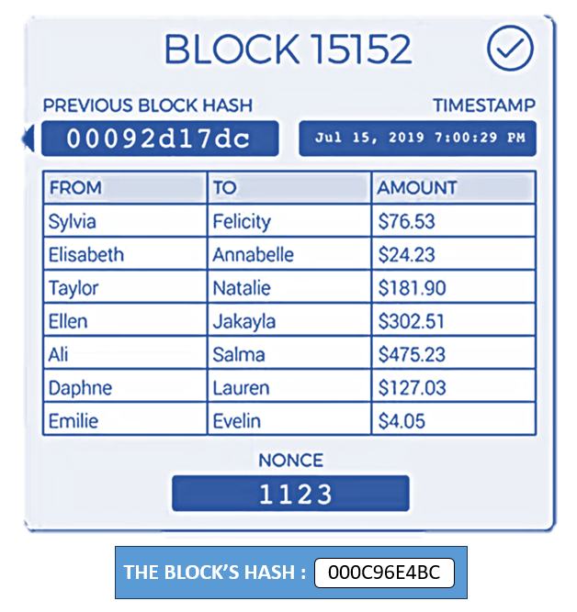
Conceptual view of the Block
The Block header consists of different metadata.
First, there is a reference to a previous block hash, which connects this block to the previous block in the block‐ chain.
The second set of metadata, namely the difficulty, timestamp, and nonce, relate to the mining competition.
The third piece of metadata is the merkle tree root, a data structure used to efficiently summarize all the transactions in the block.
The Block’s body will store the transactions and their hashes.

Slide 9
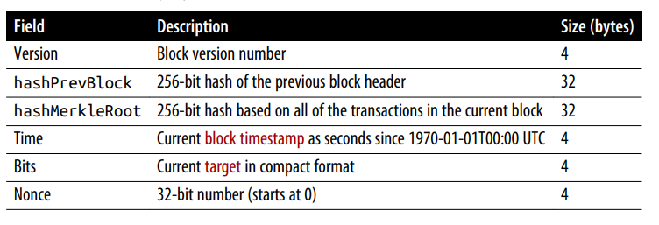
Block Header
The two most important fields in the Block_Header are hashPrevBlock, which provides a snapshot of what the Bitcoin network looked like in the previous block, and hashMerkleRoot, a snapshot of all the transactions included in the current block.

Slide 10
Transactions
Bitcoin transactions follow a unique type of accounting called UTXO, which stands for unspent transaction output.
A transaction is basically a list of inputs and a list of outputs.
Each input identifies a Bitcoin address that is acting as the source of funds, plus an unspent transaction that address has received in the past.
It also contains a digital signature proving that the owner of that address has authorized the transaction.
Each output identifies the Bitcoin address receiving the funds and the amount that address will receive.

Slide 11
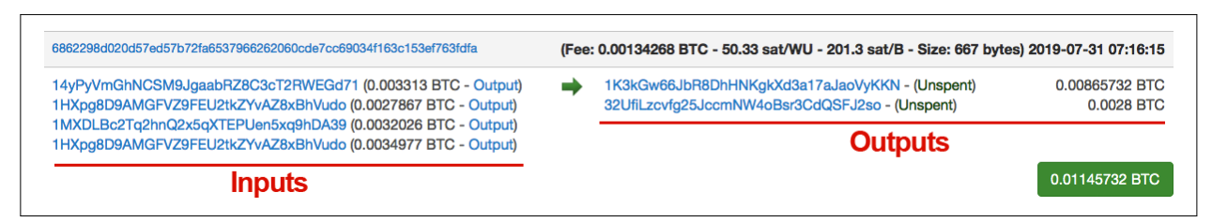
UTXO Model
Bitcoin transactions follow a unique type of accounting called unspent transaction output (UTXO). A bitcoin transaction is essentially a list of inputs and a list of outputs. Each input identifies a Bitcoin address that is providing the funds, and an unspent transaction that address has received in the past.
Similarly, each output represents the Bitcoin address receiving the funds and the amount that address receives.The difference between the input and the output is the transaction fee, which will be earned by the bitcoin miner.
Each input also contains a digital signature, proving that the owner of that Bitcoin address authorizes that transaction.

Slide 12
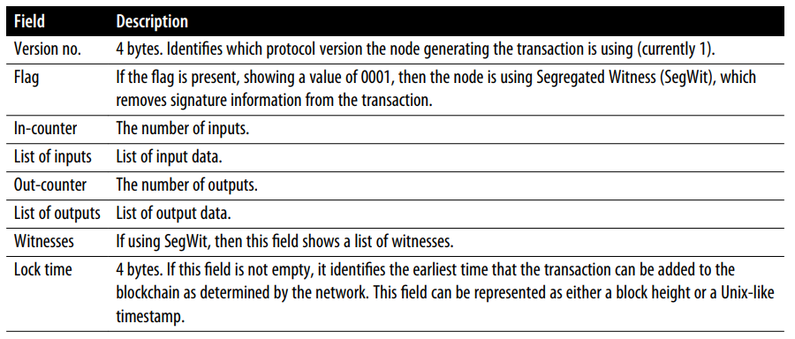
Anatomy of Transaction

Slide 13
Transaction Fees
Bitcoin transaction fees can vary depending on network capacity, how quickly confirmation is needed, and other factors.
Because there is a limit on the number of trans‐ actions that can be recorded on a block—the current limit is 1 MB of data, or roughly 3,500 transactions per block—a higher fee may be required for greater urgency.
There is essentially a competition in place for getting miners to confirm a transaction: higher fees mean faster confirmation.

Slide 14
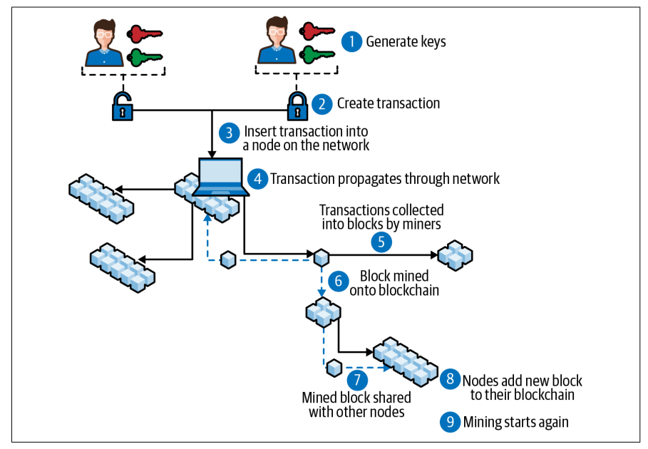
Series of events involved in executing a bitcoin transaction—“block mined onto blockchain” refers to miners adding a new block to be confirmed by the network

Slide 15
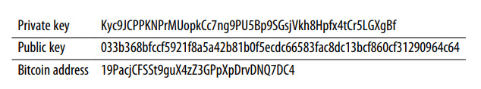
Bitcoin Address
The Bitcoin address is a translation of the public key and is the identity of the wallet where funds can be received and from which they can be sent to other addresses.
This address can be shared with anybody for receiving and sending, a bit like a username or email address. The private key is kept secret and is used to unlock stored cryptocurrency, somewhat like how you use a password to access your bank account.
Bitcoin private keys are used to digitally sign transactions. That’s how the owner of a Bitcoin address proves to the Bitcoin network that they are the rightful owner of that address, and how they authorize a transaction.
Here’s an example of what they look like:

Slide 16
Merkle Root
The Merkle root is used to show a snapshot of the state of all the transactions in the current block, stored in just 256 bits. The name comes from computer scientist Ralph Merkle, who came up with Merkle trees, which are digital signature data structures.
The Merkle root has a special purpose aside from capturing the transaction snapshot. When a node in the network wants to ensure it has the exact same list of transactions as every other node, it does not need to compare each transaction individually.
Instead, it only needs to compare its Merkle root with every other node’s Merkle root. This allows for the building of light software clients that do not require storing the entire blockchain to validate their own transactions.
To calculate the Merkle root, you first create a Merkle tree, where the leaves are the transactions in the current block.
By moving up the Merkle tree and generating hashes of all the leaves, you eventually reach the Merkle root (yes, the Merkle tree is an upside-down tree). If the number of transactions is odd, then the last transaction is replicated in order to continue this process. The Merkle root is an important value that helps to generate the block hash

Slide 17
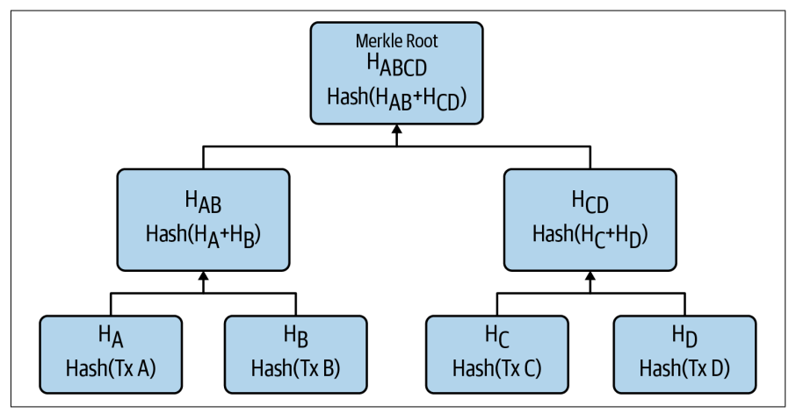
Structure of a Merkle Root
HA is the transaction (tx) hash of the first transaction, HB is the tx hash of the second transaction, and so on.
HAB is the hash of HA + HB => HA+B = SHA256( SHA256 (HA + HB )).
The hash function for Bitcoin is double SHA-256.

Slide 18
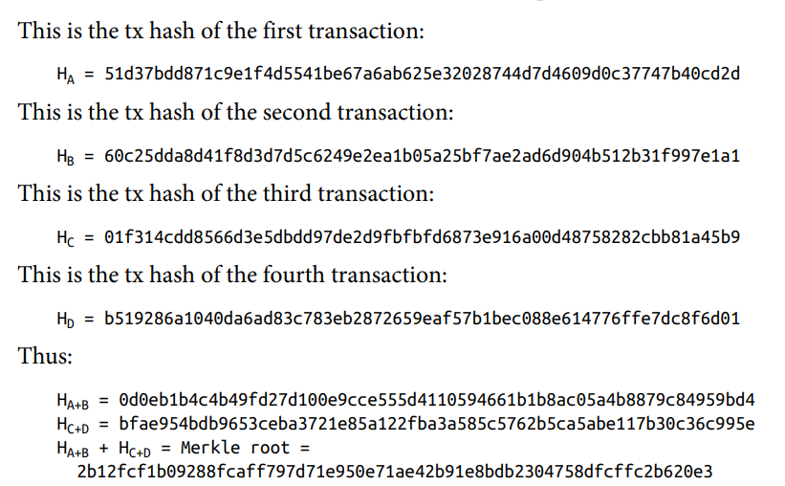
The important takeaway here is that the Merkle root can be used to quickly detect tampering in blockchain nodes.
If there has been any tampering or corruption of transactions in the blockchain on any given node, its Merkle root hash will no longer match that of the other nodes.

Slide 19


Signing and Validating Transactions
Each transaction input contains a signature that provides proof that the owner of the sending address has authorized the transaction. The signature is generated and encrypted using ECDSA, a cryptographic algorithm that takes the private key and transaction data as inputs.
Encryption process to generate a transaction signature
When all the nodes are verifying the transaction, they can easily verify the validity of the signature by using an ECDSA verify function. Verifying the signature on a transaction:

Slide 20
The Coinbase Transaction
The first transaction recorded on every block is called a coinbase transaction. It is made up of two values:
Block reward
This is the reward a miner receives from the network for performing the work to discover a block and doing their part to provide processing power to the Bitcoin network. The reward comes in the form of new bitcoin being added to the world supply.
Transaction fees
This is the sum of all the transaction fees that are included in each transaction that gets added to the current block. There are often more transactions waiting to be processed than can fit into a block, generating a marketplace for transaction fees. The faster the miner wants a transaction to be processed, the higher the fee.

Slide 21
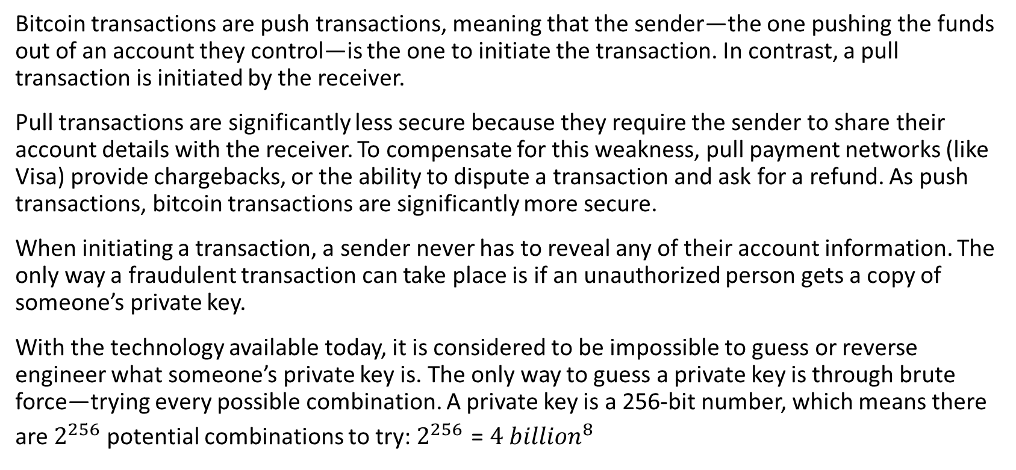
Transaction Security
Bitcoin transactions are push transactions, meaning that the sender—the one pushing the funds out of an account they control—is the one to initiate the transaction. In contrast, a pull transaction is initiated by the receiver.
Pull transactions are significantly less secure because they require the sender to share their account details with the receiver. To compensate for this weakness, pull payment networks (like Visa) provide chargebacks, or the ability to dispute a transaction and ask for a refund. As push transactions, bitcoin transactions are significantly more secure.
When initiating a transaction, a sender never has to reveal any of their account information. The only way a fraudulent transaction can take place is if an unauthorized person gets a copy of someone’s private key.
With the technology available today, it is considered to be impossible to guess or reverse engineer what someone’s private key is. The only way to guess a private key is through brute force—trying every possible combination. A private key is a 256-bit number, which means there are $2^{256}$ potential combinations to try: $2^{256}$ = ${4 billion}^{8}$

Slide 22
The combined total power of the Bitcoin network is greater than that of any of the world’s supercomputers.
Currently the bitcoin hash rate—an estimate of how many hashes are being generated by all the miners trying to solve any given block—is 90 exahashes per second. That works out to something like pow(2,128)/ (90000000000000000000*3600*24*365)=119,892,034,120 per year.
(The use of pow(2,128) is because ECDSA, the cryptographic algorithm used to generate a bit‐ coin private key, can be cracked in proportion to the square root of the key size.)
So, if you harnessed the processing power of all the miners in the Bitcoin network, it would take them this long to go through every combination: 4,589,678,828,851^37 years

Slide 23
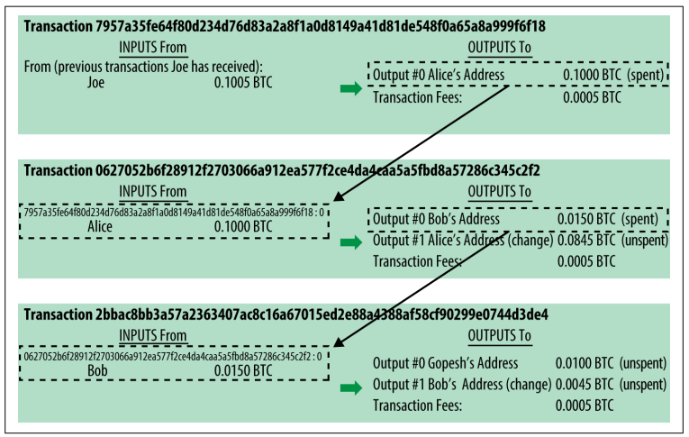
Chain of Transactions
The transactions form a chain, where the inputs from the latest transaction correspond to outputs from previous transactions.

Slide 24
Transaction’s Lifecycle
The following are the four main stages a transaction goes through:
1. Broadcast: The first step is generating a valid bitcoin transaction and then broad‐ casting the transaction details to the Bitcoin network.
2. Unconfirmed/Mempool: As every miner in the network receives the transaction, it places that transaction into its memory pool, or mempool. The mempool is a collection of all the bitcoin transactions that are in an unconfirmed state and are still considered active. By default, if a transaction has been sitting in the mem‐ pool for more than two weeks, it is considered inactive and is dropped from the mempool.
3. Confirmed by Miner: When a miner discovers a new block, the miner decides which transactions to include in that block, choosing from transactions that are sitting in the mempool. Miners choose transactions in order of transaction fees, starting with the highest ones. A transaction is considered confirmed by a miner when that miner adds a block containing that transaction to its blockchain.
4. Confirmed by the Network: As a block is buried under newer blocks, the chances that the Bitcoin network has achieved consensus to include that block increase.

Slide 25
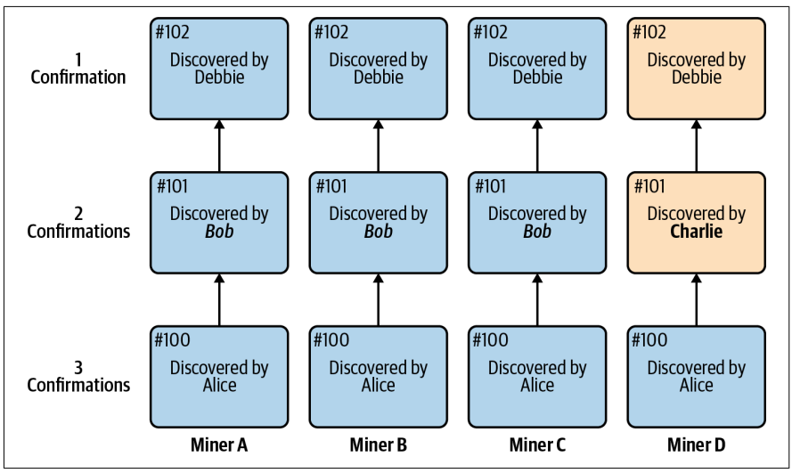
Confirmations
Bitcoin wallets, and most people in the industry, consider a transaction to be safely confirmed by the network when that transaction has reached at least six confirmations.
A confirmation involves a miner adding a block that contains transactions to the chain.
A transaction is considered to be confirmed by the entire Bitcoin network when the network has achieved consensus to include the transaction’s block in the blockchain.
Notes:
In Figure, block #100 has reached three confirmations. All four miners in the network have included the same block. At block #101, three of the miners (75%) have included the block discovered by Bob, but one (miner D) has included the block dis‐ covered by Charlie. At this moment, miner D does not realize yet that their view of the blockchain from block #101 on will have to change. If there is a transaction in miner D’s block #101 that is not in the other miners’ block #101, that transaction will not be included in the network’s blockchain. This is why the more confirmations a transaction has, the more likely it is to be included in the Bitcoin network’s blockchain

Slide 26
Consensus
Consensus is a way of reaching agreement between various participants who have shared values and goals, and it is an important component of how blockchain networks succeed.
A blockchain is a living, constantly updating document. As time goes on, more and more transactions are added to it. Users of a centralized payments network like Pay‐ Pal trust that the central authority will update its ledger with new transactions as time goes on. But in a decentralized payments network like Bitcoin, there is no central authority—just thousands of anonymous miners powering the network.
So, who should users trust to update Bitcoin’s blockchain with a new block of transactions?
Gaining that trust is called achieving consensus. It is a process that all the miners powering the network use for the following two purposes:
Block discovery - To agree on which miner gets the right to add a block of transactions.
Validation of transactions - To agree that the transactions included in that new block are legitimate.
[Consensus will be discussed in detail in later chapters]

Slide 27

Hashing vs Encryption
Encryption
Encryption is the process of converting plaintext (readable data) into ciphertext (unreadable data) using an algorithm and a key.
The primary goal of encryption is to ensure confidentiality by preventing unauthorized parties from accessing sensitive information.
Encrypted data can be decrypted back into its original form using the appropriate decryption key.
Hashing
Hashing is a one-way mathematical function that converts input data (plaintext) into a fixed-size string of characters, called a hash value or hash digest.
Unlike encryption, hashing is irreversible, meaning you cannot derive the original input from the hash value.
Hash functions are designed to be fast and deterministic, producing the same hash value for identical inputs.

Slide 28
Hashing vs Encryption
Purpose: Encryption is primarily used for confidentiality, while hashing is used for data integrity and verification.
Reversibility: Encryption is reversible (with the correct decryption key), whereas hashing is irreversible.
Key Management: Encryption often involves key management for secure key exchange, while hashing does not require keys.
Output: Encryption produces ciphertext, which can be decrypted back to plaintext. Hashing produces a fixed-size hash value, which cannot be reversed to retrieve the original input.
Use Cases: Encryption is used for securing communication and data storage, while hashing is used for data integrity, password storage, and digital signatures.
In summary, encryption and hashing are both essential cryptographic techniques with distinct purposes and applications. Encryption focuses on confidentiality and reversible transformation of data, while hashing emphasizes data integrity and irreversible transformation. Understanding the differences and appropriate use cases of each technique is crucial for implementing robust security measures.

Slide 29
Hash Cryptography
For a hash function to be cryptographically secure, we’re going to require that it has the following three additional properties:
Collision‐Resistance
Hiding
Puzzle‐Friendliness

Slide 30

Property 1: Collision‐resistance.​ The first property that we need from a cryptographic hash function is that it’s collision‐resistant. A collision occurs when two distinct inputs produce the same output. A hash function H(.) is collision‐resistant if nobody can find a collision. Formally:
Collision‐resistance: ​A hash function H is said to be collision resistant if it is infeasible to find ​two values, x and y, such that x ≠ y, yet H(x)=H(y).
This collision‐detection algorithm works for every hash function. But, of course, the problem with it is that this takes a very, very long time to do. For a hash function with a 256‐bit output, you would have to compute the hash function 2²⁵⁶ ⁺ ¹ times in the worst case, and about 2¹²⁸ times on average.

Slide 31
Property 2: Hiding ​The second property that we want from our hash functions is that it’s hiding​. The hiding property asserts that if we’re given the output of the hash function y = H(x), there’s no feasible way to figure out what the input, x, was. The problem is that this property can’t be true in the stated form.
Hiding.​A hash function H is hiding if: when a secret value r is chosen from a probability distribution that has high min‐entropy, then given H(r ‖ x) it is infeasible to find x.
In information‐theory, min‐entropy​​is a measure of how predictable an outcome is, and high min‐entropy captures the intuitive idea that the distribution (i.e., random variable) is very spread out. What that means specifically is that when we sample from the distribution, there’s no particular value that’s likely to occur.

Slide 32
Property 3: Puzzle friendliness. ​The third security property we’re going to need from hash functions is that they are puzzle‐friendly. This property is a bit complicated. We will first explain what the technical requirements of this property are and then give an application that illustrates why this property is useful.
Puzzle friendliness.​A hash function H is said to be puzzle‐friendly if for every possible n‐bit output value y, if k is chosen from a distribution with high min‐entropy, then it is infeasible to find x such that H(k ‖ x) = y in time significantly less than 2^{n}.

Slide 33
Cryptography
Public/private key cryptography
Bitcoin uses public/private key cryptography to prove the validity of a transaction.
Private keys in Bitcoin are used to digitally sign bitcoin transactions, which is the way the owner of a Bitcoin address proves to the network that they are the rightful owner of that address. Private keys authorize a transaction. They are kept secret, much like passwords.
Public keys in Bitcoin are only used to generate a Bitcoin address. The address is essentially a compressed version of the public key, making it somewhat easier to read. A Bitcoin address is a value that can be shared publicly with anyone, usually when asking someone to send bitcoin. In this way, it’s a bit like an email address.
Generating keys
A private key is a 256-bit number that is chosen at random. Private keys are almost always shown in hexadecimal format. The private key is generated by a computer, most programming languages have a function to randomly generate a number.

Slide 34
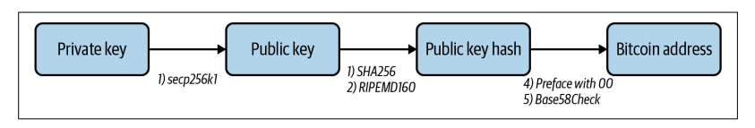
A private key can be paired with a public key to make transactions on the Bitcoin network. Without a private key it is, by design, nearly impossible to do so.
In cryptography, a public key can be generated by running the private key through an Elliptic Curve Digital Signature Algorithm (ECDSA) secp256k1 function.
A public key hash is then generated by running the public key through the cryptographic SHA256 and RIPEMD160 functions.
The Bitcoin address is generated by first adding 00 to the public key hash and then running that value through a Base58Check function.
Here is an illustration of the process of generating a Bitcoin address from a private key.

Slide 35
Digital Signatures
A digital signature is supposed to be the digital analog to a handwritten signature on paper.
We desire two properties from digital signatures that correspond well to the handwritten signature analogy.
Firstly, only you can make your signature, but anyone who sees it can verify that it’s valid.
Secondly, we want the signature to be tied to a particular document so that the signature cannot be used to indicate your agreement or endorsement of a different document.
For handwritten signatures, this latter property is analogous to assuring that somebody can’t take your signature and snip it off one document and glue it onto the bottom of another one.

Slide 36
Digital Signatures
A digital signature scheme consists of the following three algorithms:
(sk, pk) := generateKeys(​keysize​) ​
The generateKeys method takes a key size and generates a key pair. The secret key sk is kept privately and used to sign messages. pk is the public verification key that you give to everybody. Anyone with this key can verify your signature.
sig := sign(​sk​, ​message​) ​
The sign method takes a message and a secret key, sk, as input and outputs a signature for message under sk
isValid := verify(​pk​, ​message​, ​sig​) ​
The verify method takes a message, a signature, and a public key as input. It return a boolean value, isValid, that will be true​ if sig is a valid signature for message under public key pk, and false ​otherwise.
We require that the following two properties hold:
Valid signatures must verify - verify​(pk, message, sign​(sk, message)) == true
Signatures are existentially unforgeable

Slide 37
